Slide 1
Advance Java
JSP Basics
LEVEL – PRACTITIONER

Slide 2
About the Author
Created By: | Renjith(t-renjith)/ Shanmu (105110)
Credential Information: | Trainer / Sr Architect
Version and Date: | 1.0, January 10’th 2012
Cognizant Certified Official Curriculum
Notes:
For tde animators:
tdis screen content needs to be rendered in tde flash, no animations needed.

Slide 3









Icons Used
Hands on Exercise
Questions
Tools
Coding Standards
Test Your Understanding
Case Study
Best Practices & Industry Standards
Demonstration
Workshop

Slide 4
Objectives
After completing this chapter you will be able to understand:
What is JSP ?
Life Cycle of JSP.
Difference between JSP and Servlet.

Slide 5
What is a JSP ?
JSP files are HTML files with special tags that contain Java source code that provide dynamic content.
Example: Google Search engine, the search page is dynamic will display the search results based on the user’s search request.
Page is referred as dynamic as the same page displays different data based on different user input.

Slide 6
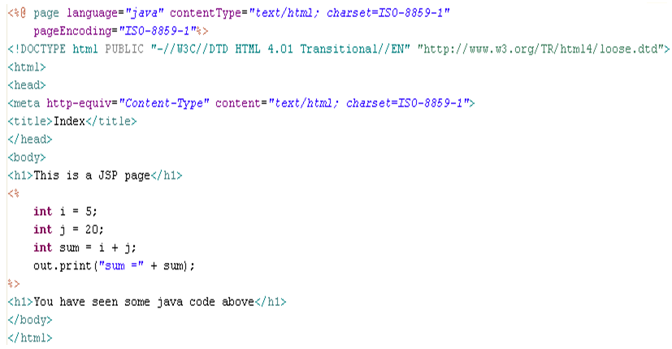
Sample JSP page
Java code embedded inside HTML tags using <%%> tags. This is the basic structure of JSP

Slide 7
Servlet Vs JSP
In Servlets html is written inside java code using print statements. In jsp java code is embedded inside HTML
JSP pages are converted to servlets by the web container so actually it can do the same thing as Java Servlets.
JSP are easier for creating HTML content but servlets are easier for writing the java code.
A combination of JSP and Servlet can be used to separate the presentation (HTML) and logic (java code) and taking the advantage of both.

Slide 8
JSP Life Cycle Phases
Translation & Compilation
The JSP will be translated into Servlet Java file and compiled to servlet class by the web container.
Instantiation
JSP is destroyed by the web container when the application is uninstalled.
The web container creates an instance of the servlet class.
Initialization
The web container instantiates the servlet and makes it ready for servicing the request.
Service
This is the phase during which the jsp services the user requests
Destroy

Slide 9

Jsp Life Cycle methods
The following methods will be generated by the web container when translating the JSP to the Servlet Java file.
jspInit() - The web container calls the jspInit() to initialize the servlet instance generated. It is invoked before servicing the client request and invoke only once for a servlet instance.
_jspservice() - The container calls the jspservice() for each user request, passing it the request and the response objects.
jspDestroy() - The container calls this when it decides take the instance out of service. It is the last method called in the servlet instance.

Slide 10


JSP Life Cycle with a demo
Jack logins
Into mypay site
Tim logins
Into mypay site
WEB CONTAINER
When Tim Logs in the container invokes only the service method.
CTSMypay.jsp
Response sent back to Jack
Web container translates the JSP into a servlet Java file
Response sent back to Tim.
CTSMypay_jsp.java
(Servlet)
service
Web container invokes the _jspservice() for Jack’s request.
When application is uninstalled the destroy() method of the JSP will be invoked
Web container compiles the servlet Java into a class file.
CTSMypay_jsp.class
initialization
Web container invokes jspInit() and instantiates the class.
instantiation
destroy
Web container initializes the servlet

Slide 11
Lend a Hand : JSP Jump Start
Here we will create a web application with a simple jsp page which prints a message “Welcome to JSP” .
This Demo is meant for understanding the following things
How to deploy a JSP application?
What happens to the JSP when it is deployed?
How to call the jsp page from the browser?
Note : We will not be covering the details of the jsp components which will be covered in the coming slides . Demo just meant to see a basic view of a JSP page.

Slide 12
Lend a Hand : Lets Start Development
Steps for Development
Step 1 : Open SDE and Create a dynamic Web project
Step 2 : Create index.jsp
Step 3 : Deploy the application

Slide 13
Lend a Hand : Step 1 : Create a Dynamic Web Project
Open SDE and Create a Dynamic WebProject named “JSPDemo”

Slide 14
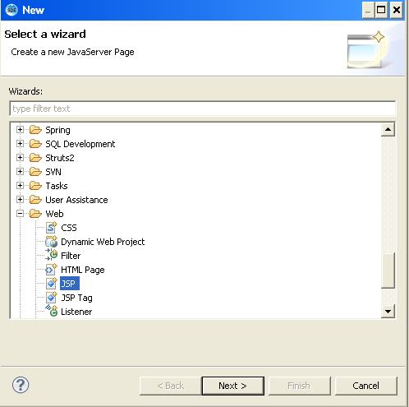
Lend a Hand : Step 2 : Create index.jsp
Right click webcontent →Click new → Click other→Click web
Select JSP.

Slide 15
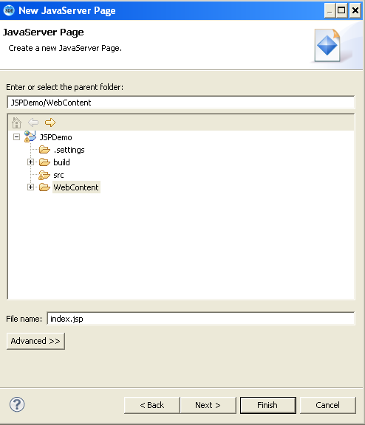
Lend a Hand : Step 2 : Create index.jsp (Cont)
Enter the file name as index.jsp
Enter finish and finish the process

Slide 16
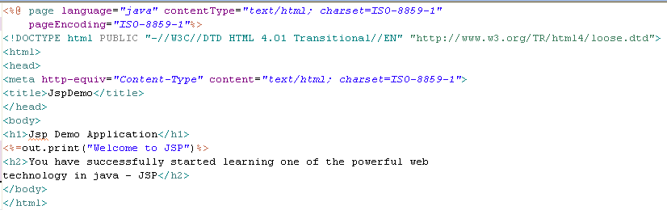
Lend a Hand : Code Of index.jsp
Add the highlighted code in the JSP file created.

Slide 17
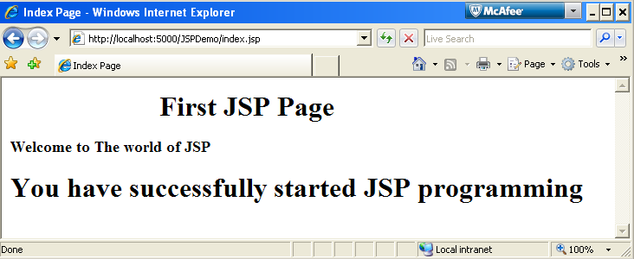
Lend a Hand : Step 3 – Deploy and Run
Right click the application and run it using the option
Run As→ Run on Server
Call index.jsp from the browser
http://localhost:5000/JSPDemo/index.jsp
NOTE: Ensure the port number and context are correct.

Slide 18

What happened to the Index JSP?
The JSP which you had created would have been converted to a servlet file and compiled as class for servicing users request.
You can find this file in the web server folder where the applications is deployed. The web server creates a temporary folder for extracting these files.
NOTE: The folder path varies between web servers.
Lets see how our generated java file of index.jsp looks like.

Slide 19
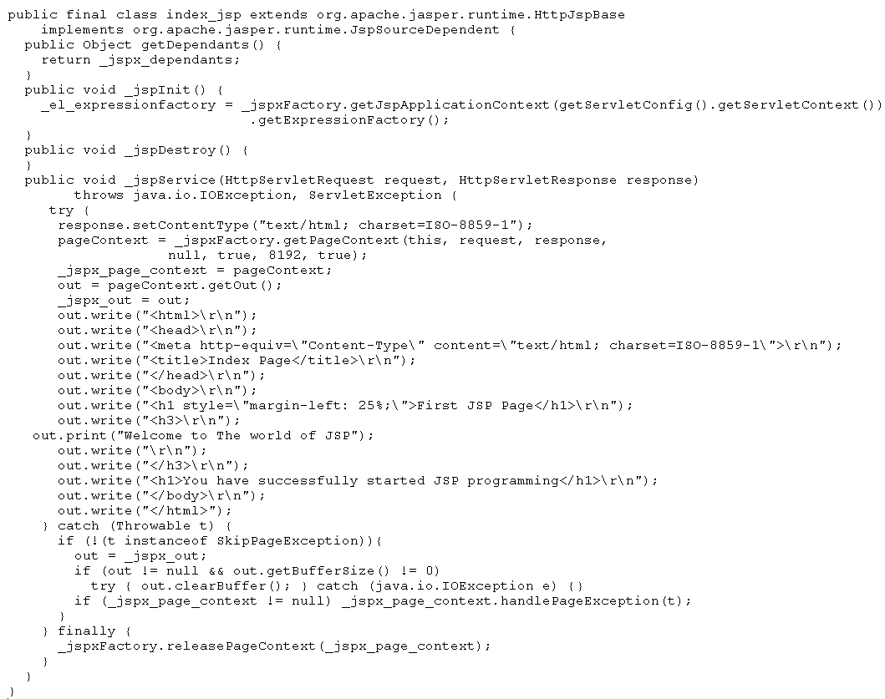
What happened to the Index JSP?
The service, init and destroy methods generated by the web container.
The Index.jsp translated to Java code.

Slide 20

Time To Reflect
Associates to quickly summarize the following before ending the session
What is JSP?
What is the first phase in JSP life cycle?
When & how many times the jsp_init will be fired?
What is the use of jsp service method?

Slide 21
Advance Java
You have successfully completed –
Servlet Filters

